Slide 1
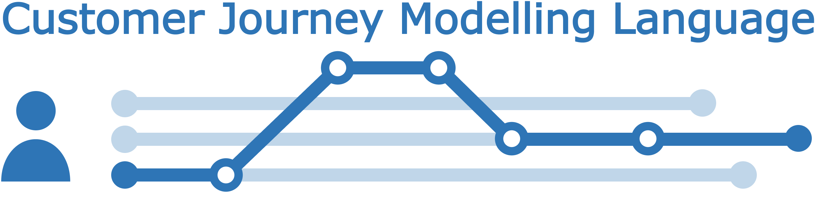
Diagram generator
CJML - Customer Journey Modelling Language
Version 2.0
SINTEF Digital
November 2022

Slide 2



Overview of CJML 2.0 resources
The CJML material consists of several modules that are to be seen in connection to each other.
All the CJML resources, including tools and documentation, can be found here: www.cjml.no
Introduction
Overview, purpose and target group
Modelling approach
Visual notation
Diagrams types and symbols
Features and examples
Diagram generator
Templates for easy diagramming
Examples
Main change in this version:
An expanded terminology and a data exchange format
Change in the visual notation of the journey network diagram (message flow between sender and receiver)
Terminology
Definitions, attributes, and class diagrams
Meta-model
Data format
XML schema
XML examples
XML description
CJML v2.0 by SINTEF Digital is licensed under the Creative Commons Attribution-ShareAlike 4.0 International License.
The current version of CJML was developed in the research project Smart Journey Mining funded by the Research Council of Norway (grant no. 312198).

Slide 3
Contents
Readers guide
  Who can use this material?
  Additional resources
Overview
  Diagram types – planned journey
  Diagram types – actual journey
  Comparison through an example
  Guidelines for developing a scenario
Symbol gallery
Templates – customer journey diagram
Templates – journey network diagram
Examples – customer journey diagram
Examples – journey network diagram

Slide 4
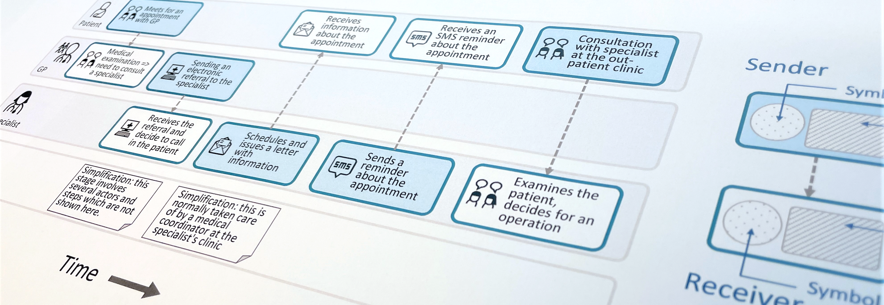
CJML - Customer Journey Modelling Language
CJML is a visual language dedicated to modelling of human journeys, regardless of whether the human has the role of customer, user, patient, or citizen.
Customer journey
User journey
Employee journey
Patient journey
Citizen journey

Slide 5
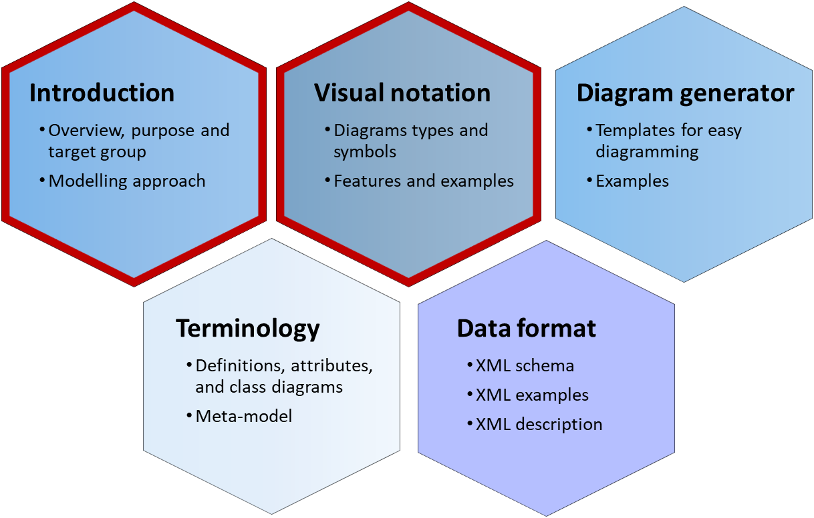
Overview
The following slides assume that you are familiar with the basics of CJML, available in the modules Introduction and Visual notation.
Diagram types – planned journey
Diagram types – actual journey
Comparison through an example
Guidelines for developing a scenario

Slide 6

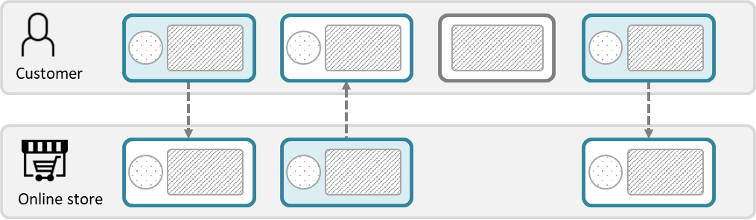

Diagram types – planned journey
Customer journey diagram
Suitable when focusing only on the end-user
Suitable when few actors are involved
Journey network diagram (“swimlane diagram”)
Suitable when several actors are involved
Reveals both the sender and the receiver of a communication point
Emphasizes the direction of the message flow
The boundary colours are free of choice, but must be consistent (representing the initiating actor).
This diagram has two predefined colours, distinguishing the initiator from the receiver.
There is an implicit time axis running from left to right
Time
Note the difference in how a communication point appears in the two diagram types.

Slide 7
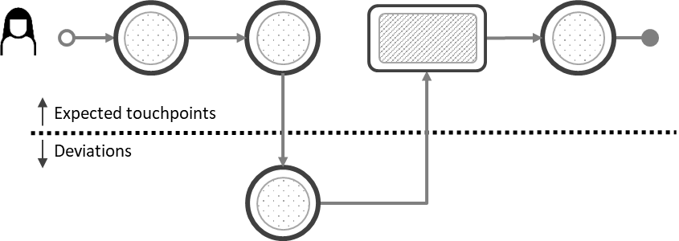
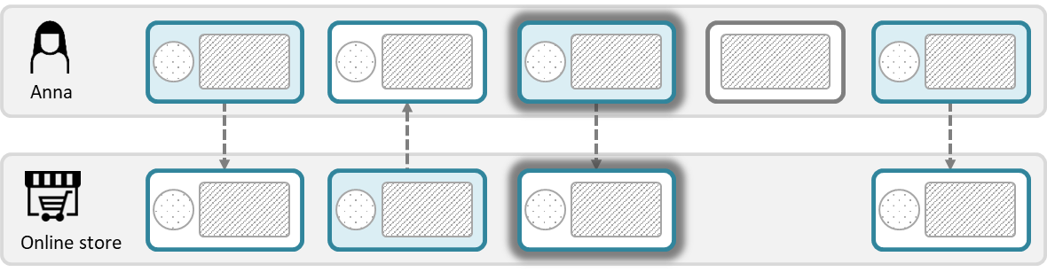
Diagram types – actual journey
Customer journey diagram
Suitable when focusing only on the end-user
Suitable when few actors are involved
Suitable when emphasizing deviations from the planned journey
Journey network diagram (“swimlane diagram”)
Suitable when several actors are involved
Reveals both the sender and the receiver of a communication point
Emphasizes the direction of the message flow
Ad-hoc touchpoints also appear differently in the two diagram types.

Slide 8
Comparison through an example
Here, an online bookstore is used as an example to compare the two diagram types. The next slide shows the diagrams.
Planned journey (as envisioned by the bookstore)
Actual journey (Tom, a fictitious character)
T1: The customer orders books online through the bookstore’s web application.
T1.1: The bookstore receives the order and forwards it to their financial partner. (This step is not part of the customer’s journey.)
T2: The financial partner sends the invoice to the customer.
T3: The customer pays the invoice
T3.1: The financial partner confirms the payment to the online store (This step is not part of the customer’s journey.)
T4: The customer receives the books.
T1: Tom orders books online through the bookstore’s web application.
T2: Tom receives the invoice from the financial partner.
D2.1: Tom discovers a hidden delivery fee when studying the invoice.
D2.2: Tom calls the financial partner to clarify the issue and realizes that he was not attentive when ordering the books. Tom is now dissatisfied as the fee was not presented more clearly.
T3: Tom pays the invoice.
T4: Tom receives the package in his mailbox.
Deviation

Slide 9
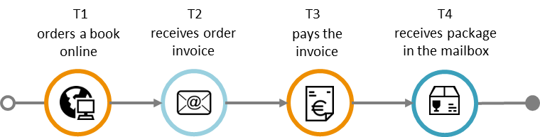
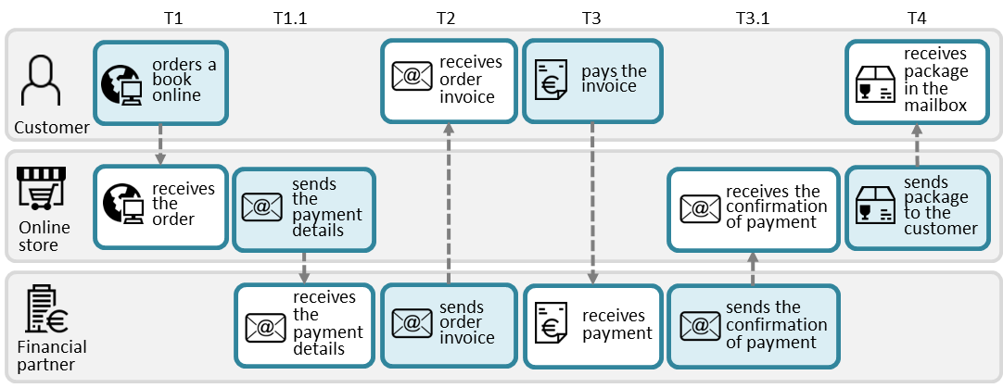
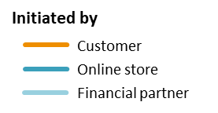
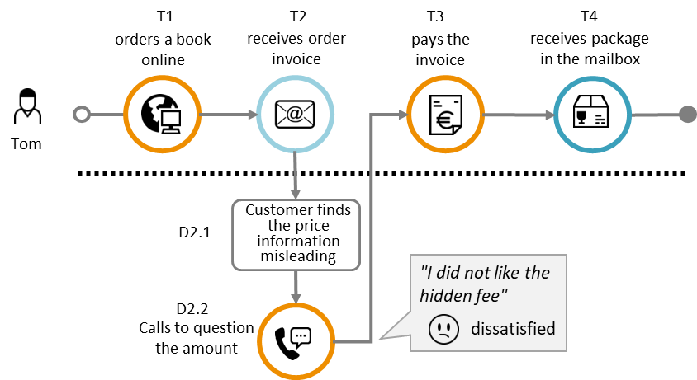
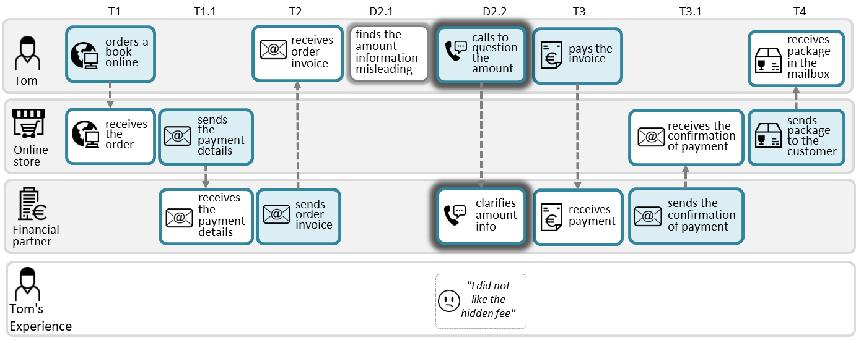
Online bookstore example shown with both diagram types.
See the last section “examples” for templates.
Customer Journey Diagram
Journey Network Diagram
Planned journey
The planned journey for a typical customer. This diagram only shows the touchpoints encountered by the customer, and corresponds to the upper swimlane to the right.
Planned journey
The network diagram includes two touchpoints (i.e., T1.1 and T3.1) which are invisible to the customer, however necessary to “produces” the customer’s next touchpoint
Actual journey
The actual customer journey for Tom, a fictitious character. Tom’s journey contains an unexpected call which is emphasized in this deviation diagram.
Actual journey
The actual customer journey for Tom, a fictitious character. Tom’s customer journey contains deviations.

Slide 10
Guidelines for developing a scenario
Making a diagram is easy if you have a detailed scenario. The following guidelines can be useful in creating such a scenario.
Identify key actors, user goal, and purpose
  Who is the end-user in your case (customer, patient, employee, etc.) and what is the user goal?
  Which other actors are involved?
  Purpose: do you want to model a planned journey (how it should be) or an actual journey (real example or fictitious case)?
Zoom out: envision the timeline from start to end
  What could be a convenient start of the scenario? How does it develop over time? What can be a suitable end point for the scenario?
  What major phases are involved in the journey? What steps are essential?
  In what ways do the actors communicate? (digital versus face-to-face)
  If there are many decision points and sub-branches select a typical or common journey.
Zoom in: touchpoints and essential attributes
  Who is the initiator of a communication point?
  Who is the receiver?
  Which communication channel is used?
  Are there any essential actions (non-communicating events) to be included?
Connect the touchpoints into a journey
  Think about the timeline from start to end
  Arrange the touchpoints chronologically from start to end.
  Check if anything is missing to form a consistent story.
  Use a comment field for any clarifications or simplifications
Find the suitable diagram type for your purpose
  If you have many actors involved it is better to use a journey network diagram
  If you have actual journeys with many deviations, a journey diagram is recommended

Slide 11
Templates – customer journey Diagram
Planned journey
Actual journey
Compliance – deviation diagram
User experience and phase

Slide 12












Planned journey
Who initiates the touchpoint? (colour)
Choose symbol
Insert the touchpoints (communication points and actions) and connect them. Give a short text to explain, and insert a symbols for the communication channel (for circles only).
T1
T2
T3
T4
<Insert a short description>
<Insert a short description>
<Insert a short description>
<Insert a short description>
Planned journey, no Actions
Customer
Service providers
T1
T2
T3
T4
<Insert a short description>
<Insert a short description>
<Insert a short description>
Planned journey with Action
<Description of
the action>
Here are the most common channel symbols. Please refer to the symbol gallery for a full overview.

Slide 13
Planned journey – variable length
T1
T2
T3
T4
T5
<Insert a short description>
<Insert a short description>
<Insert a short description>
<Insert a short description>
<Insert a short description>
5 touchpoints
T1
T2
T3
T4
T5
T6
<Insert a short description>
<Insert a short description>
<Insert a short description>
<Insert a short description>
<Insert a short description>
<Insert a short description>
6 touchpoints
T1
T2
T3
T4
T5
T6
T7
<Insert a short description>
<Insert a short description>
<Insert a short description>
<Insert a short description>
<Insert a short description>
<Insert a short description>
<Insert a short description>
7 touchpoints

Slide 14
Actual journey
Who initiates the touchpoint? (colour)
Choose symbol
T1
T2
T3
T4
<Insert a short description>
<Insert a short description>
<Insert a short description>
<Insert a short description>
Actual journey, no Actions
Customer
Service providers
T1
T2
T3
T4
<Insert a short description>
<Insert a short description>
<Insert a short description>
Actual journey with Action
<Description of
the action>
Herer are the most common channel symbols. Please refer to the symbol gallery for a full overview.

Slide 15
Actual journey – variable length
T1
T2
T3
T4
T5
<Insert a short description>
<Insert a short description>
<Insert a short description>
<Insert a short description>
<Insert a short description>
5 touchpoints
T1
T2
T3
T4
T5
T6
<Insert a short description>
<Insert a short description>
<Insert a short description>
<Insert a short description>
<Insert a short description>
<Insert a short description>
6 touchpoints
T1
T2
T3
T4
T5
T6
T7
<Insert a short description>
<Insert a short description>
<Insert a short description>
<Insert a short description>
<Insert a short description>
<Insert a short description>
<Insert a short description>
7 touchpoints

Slide 16

Compliance - deviation diagram
Compliance can be addressed in case of actual journeys when you have knowledge about the planned journey.
In case of a deviation, the touchpoint is put below the broken line.
The circle's boundary style indicates the status of the communication point
  Solid boundary: completed as expected (above the line) or ad-hoc (below the line).
  Dashed boundary: missing.
  Crossed touchpoint: failing.
Completed and ad-hoc
Missing
Failing
Examples
T1
T2
T3
T4
T5
<Insert a short description>
<Insert a short description>
<Insert a short description>
<Insert a short description>
Actual journey
Customer fails to buy a train ticket
Customer didn’t receive the call
Expected touchpoints
Deviations
D1
<Insert a short description>

Slide 17





User experience and phase
Detailed template for deviations and user experiece
Phase 1
Phase 2
T1
T2
T3
T4
T5
User experience
<Insert a short description>
<Insert a short description>
<Insert a short description>
<Insert a short description>
<Insert a short description>
Text based on the user’s self-reported feedback
<Insert a short description>
Rating (text)
Emoticon
D2.1
<Insert a short description>
very
dissatisfied
very
satisfied
dissatisfied
satisfied
neutral
D2.2
<Insert a short description>

Slide 18
Templates – journey network diagram
3 actors | comment field | user experience
4 actors | comment field | user experience
Journey phase and touchpoint ID
Compliance

Slide 19
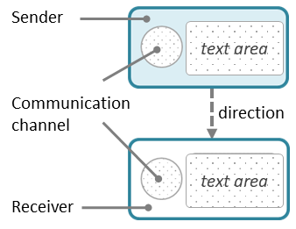




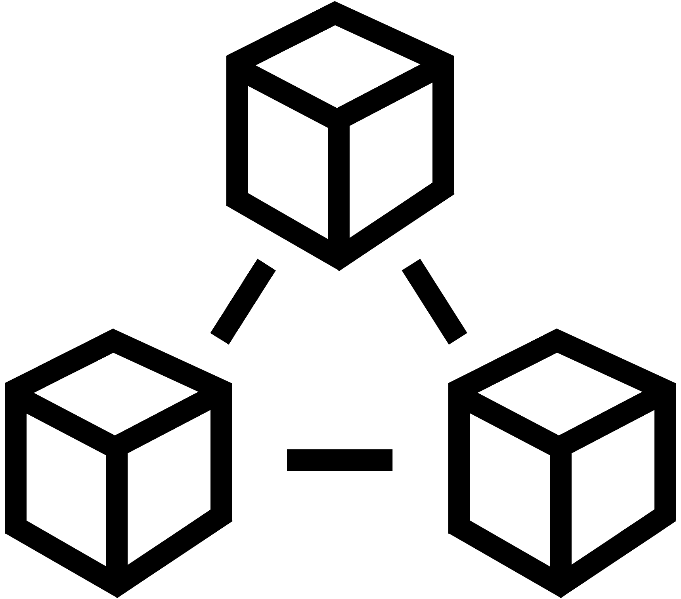


Three actors
Position each part of the communication point in the correct swimlane.
Use an action element for non-communicating events
Identify the involved actors and find suitable icons to represent them (see more alternatives in the symbol gallery).
<describe the action>
<Short text explaining the sending side>
<Short text explaining the receiving side>
<Actor 1>
<Short text explaining the receiving side>
<Short text explaining the sending side>
<Actor 2>
<Short text explaining the receiving side>
<Short text explaining the sending side>
<Actor 3>
Choose symbol for the communication channel, see the symbol gallery.
<Short text explaining the sending side>
<Short text explaining the sending side>
<Short text explaining the receiving side>
<Short text explaining the receiving side>
<describe the action>
<describe the action>
<Short text explaining the receiving side>
<Short text explaining the receiving side>
<Short text explaining the sending side>
<Short text explaining the sending side>
<describe the action>

Slide 20

Three actors + comments
Position each part of the communication point in the correct swimlane.
Use an action element for non-communicating events
Identify the involved actors and find suitable icons to represent them (see more alternatives in the symbol gallery).
<describe the action>
<Short text explaining the sending side>
<Short text explaining the receiving side>
<Actor 1>
<Short text explaining the receiving side>
<Short text explaining the sending side>
<Actor 2>
<Short text explaining the receiving side>
<Short text explaining the sending side>
<Actor 3>
This is a comment for this specific touchpoint
Comment
Choose symbol for the communication channel, see the symbol gallery.
<Short text explaining the sending side>
<Short text explaining the sending side>
<Short text explaining the receiving side>
<Short text explaining the receiving side>
<describe the action>
<describe the action>
<Short text explaining the receiving side>
<Short text explaining the receiving side>
<Short text explaining the sending side>
<Short text explaining the sending side>
<describe the action>

Slide 21
Three actors + user experience
Position each part of the communication point in the correct swimlane.
Use an action element for non-communicating events
Identify the involved actors and find suitable icons to represent them (see more alternatives in the symbol gallery).
<describe the action>
<Short text explaining the sending side>
<Short text explaining the receiving side>
<Actor 1>
<Short text explaining the receiving side>
<Short text explaining the sending side>
<Actor 2>
<Short text explaining the receiving side>
<Short text explaining the sending side>
<Actor 3>
<describe the end-user experience>
<describe the end-user experience>
Actor 1’s experience
Describe experience and add symbol.
<describe the end-user experience>
<describe the end-user experience>
Choose symbol for the communication channel, see the symbol gallery.
<Short text explaining the sending side>
<Short text explaining the receiving side>
<describe the action>
<describe the action>
<describe the end-user experience>
<describe the end-user experience>
<Short text explaining the receiving side>
<Short text explaining the sending side>
very unsatisfied
unsatisfied
neutral
satisfied
very satisfied

Slide 22
Four actors
Identify the involved actors and find suitable icons to represent them in the symbol gallery.
<describe the action>
<Short text explaining the sending side>
<Actor 1>
<Short text explaining the receiving side>
<Actor 2>
<Actor 3>
<Actor 4>
Choose symbol for the communication channel, see the symbol gallery.
<Short text explaining the sending side>
<Short text explaining the sending side>
<Short text explaining the receiving side>
<Short text explaining the receiving side>
<describe the action>
<describe the action>
<Short text explaining the receiving side>
<Short text explaining the receiving side>
<Short text explaining the sending side>
<Short text explaining the sending side>
<describe the action>

Slide 23
Four actors + comments
Identify the involved actors and find suitable icons to represent them in the symbol gallery.
<describe the action>
<Short text explaining the sending side>
<Actor 1>
<Short text explaining the receiving side>
<Actor 2>
<Actor 3>
<Actor 4>
This is a comment for this specific touchpoint
Comment
Choose symbol for the communication channel, see the symbol gallery.
<Short text explaining the sending side>
<Short text explaining the sending side>
<describe the action>
<describe the action>
<Short text explaining the receiving side>
<Short text explaining the receiving side>
<describe the action>

Slide 24
Four actors + user experience
Identify the involved actors and find suitable icons to represent them in the symbol gallery.
<describe the action>
<Short text explaining the sending side>
<Actor 1>
<Short text explaining the receiving side>
<Actor 2>
<Actor 3>
<Actor 4>
<describe the end-user experience>
<describe the end-user experience>
Actor 1’s experience
Describe experience and add symbol.
<describe the end-user experience>
<describe the end-user experience>
Choose symbol for the communication channel, see the symbol gallery.
<Short text explaining the sending side>
<Short text explaining the receiving side>
<describe the action>
<describe the action>
<describe the end-user experience>
<describe the end-user experience>
<Short text explaining the receiving side>
<Short text explaining the sending side>
very unsatisfied
unsatisfied
neutral
satisfied
very satisfied

Slide 25
Journey phase: plain
Phase 1
Phase 2
Phase 2
Journey phase: detailed
Booking of appointment
Outpatient clinic
April 13th 1 p.m.
April 27th
April 30th
Journey phase and touchpoint iD
Phase 1
Phase 2
Phase 2
T1
T2
T3
D3
T4
T4
<describe the action>
<Short text explaining the sending side>
<Short text explaining the receivingside>
<Short text explaining the sending side>
<Short text explaining the sending side>
<Actor 1>
<Short text explaining the receiving side>
<Short text explaining the sending side>
<Short text explaining the receiving side>
<Actor 2>
<Short text explaining the receiving side>
<Short text explaining the sending side>
<Short text explaining the receiving side>
<Actor 3>

Slide 26
Compliance
Journey network diagrams are generally not suitable for sequence errors
Compliance can be addressed in case of actual journeys and awareness of the planned journey.
The shape's boundary style carries information about the touchpoint status, as illustrated to the right.
When it is important to outline deviations relative to a planned journey, a deviation diagram may be more suitable.
Normal
Ad-hoc
Failing
Missing
<Short text explaining the sending side>
<Short text explaining the receiving side>

Slide 27
Symbol gallery
Actors and end-user experience
Communication channels

Slide 28














































Actors and user experience
General symbols
Users and customers
user13
user14
user15
user16
user17
user18
user19
user20
user21
user1
user2
user3
user4
user5
user6
user7
user8
user9
user10
user11
user12
Service providers
service provider1
service provider2
service provider3
service provider4
service provider5
service provider6
store1
store2
store3
store4
online store1
online store2
bank1 online
bank2 online
bank3
bank4
bank5
bank6
Employee - general
employee7
employee8
employee9
employee10
employee11
employee12
employee13
employee14
employee15
employee16
employee1
employee2
employee3
employee4
employee5
employee6
IT staff and technicians
User/customer experience
staff IT1
staff IT2
staff3 IT3
staff tech1
staff tech2
staff tech3
Platforms and systems
1 very unsatisfied
2 unsatisfied
3 neutral
4 satisfied
5 very satisfied
tech1 database
tech2 database
tech3 server
tech4 virtual machine
tech5 cloud
tech6 network
tech7 system
tech8 system cloud

Slide 29










Communication channels
General symbols
These are the recommended symbols for general use. The extended symbol set can be found in the Visual notation.
telephone conversation
face-to-face interaction
payment channel
SMS
shop counter
letter
e-mail
service desk
self-service machine
chat
social media message
fax message
package delivery
message service
internet/globe
app on smartphone
internet via smartphone
unknown channel
app on PC
internet via PC
app on tablet
internet via tablet

Slide 30





















Healthcare actor symbols
Healthcare symbols
Patients
patient-1
patient-2
patient-3
Doctors and surgeons
Health secretaries
doctor-1
doctor-2
doctor-3
doctor-4
health-secretary-1
health-secretary-2
secretary-receptionist-1
secretary-receptionist-2
Nurses
Health systems
nurse-1
nurse-2
nurse-3
nurse-4
chief-nurse
hospital-computer-system
hospital-post-office
patient-medical-record-1
patient-medical-record-2
patient-medical-record-3
Hospitals and health systems
hospital-1
hospital-2
hospital-3
hospital-4

Slide 31









































Healthcare actor symbols - extra
Healthcare symbols
doctor - general practitioner
doctors
surgeons
anaesthesiologists
nurses
chief nurses
health secretaries
secretaries/receptionists
medical practices

Slide 32




















Cyber security symbols
Cyber security symbols
Cyber security experts
cyber security expert 1
cyber security expert 2
cyber security expert 3
cyber security expert 4
cyber security expert 5
cyber security expert 6
cyber security expert 7
cyber security expert 8
cyber security expert 9
Attackers / cyber criminals
attacker
attacker network
attacker physical
attacker software
attacker social engineering
Special symbols
threat
unwanted incident
vulnerability lock
vulnerability unlock
firewall
danger2

Slide 33
Examples – customer journey diagram
Bookstore example:
Planned journey
Actual journey – deviation and customer experience

Slide 34

Planned journey - bookstore example
Planned journey (as envisioned by the bookstore)
  T1: The customer orders books online through the bookstore’s web application.
  T2: The financial partner sends the invoice to the customer.
  T3: The customer pays the invoice
  T4: The customer receives the books.
T1
T2
T3
T4
orders a book
online
receives order invoice
pays the invoice
receives package in the mailbox
Initiated by
Customer
Online store
Financial partner

Slide 35

Actual journey – deviations and customer experiece
Actual journey (Tom, a fictitious character)
  T1: Tom orders books online through the bookstore’s web application.
  T2: Tom receives the invoice from the financial partner.
  D2.1: Tom discovers a hidden delivery fee when studying the invoice.
  D2.2: Tom calls the financial partner to clarify the issue and realizes that he was not attentive when ordering the books. Tom is now dissatisfied as the fee was not presented more clearly.
  T3: Tom pays the invoice.
  T4: Tom receives the package in his mailbox.
T1
T2
T3
T4
orders a book
online
receives order invoice
pays the invoice
receives package in the mailbox
Tom
Customer finds
the price information misleading
D2.1
"I did not like the hidden fee"
D2.2
dissatisfied
Calls to question the amount

Slide 36
Examples– journey network diagram
Bookstore example:
Planned journey
Actual journey – deviation and customer experience
Healthcare example

Slide 37


Planned journey - bookstore example
Planned journey (as envisioned by the bookstore)
  T1: The customer orders books online through the bookstore’s web application.
  T1.1: The bookstore receives the order and forwards it to their financial partner.)
  T2: The financial partner sends the invoice to the customer.
  T3: The customer pays the invoice
  T3.1: The financial partner confirms the payment to the online store (This step is not part of the customer’s journey.)
  T4: The customer receives the books.
T1
T1.1
T2
T3
T3.1
T4
orders a book online
receives order invoice
pays the invoice
receives package in the mailbox
Customer
receives the order
sends the payment details
receives the confirmation of payment
sends package to the customer
Online
store
receives the payment details
sends order invoice
receives payment
sends the confirmation of payment
Financial
partner

Slide 38
Actual journey – bookstore example
Actual journey (Tom, a fictitious character)
  T1: Tom orders books online through the bookstore’s web application.
  T1.1: The bookstore receives the order and forwards it to their financial partner.)
  T2: Tom receives the invoice from the financial partner.
  D2.1: Tom discovers a hidden delivery fee when studying the invoice.
  D2.2: Tom calls the financial partner to clarify the issue and realizes that he was not attentive when ordering the books. Tom is now dissatisfied as the fee was not presented more clearly.
  T3: Tom pays the invoice.
  T3.1: The financial partner confirms the payment to the online store (This step is not part of the customer’s journey.)
  T4: Tom receives the package in his mailbox.
T1
T1.1
T2
D2.1
D2.2
T3
T3.1
T4
orders a book online
receives order invoice
finds the amount information misleading
calls to question the amount
pays the invoice
receives package in the mailbox
Tom
receives the order
sends the payment details
receives the confirmation of payment
sends package to the customer
Online
store
receives the payment details
sends order invoice
clarifies amount info
receives payment
sends the confirmation of payment
Financial
partner
"I did not
like the
hidden fee"
Tom’s experience is represented in a separate swimlane.
Tom's Experience

Slide 39






Healthcare: A MS patient journey – (1/2)
BOOKING OF APPOINTMENT
OUTPATIENT CLINIC
April 13th 1 p.m.
April 18th
April 27th
April 30th
I need to book a new appointment at the outpatient clinic, but it is already too late.
Calls the outpatient clinic to book an appointment.
Receives a reminder.
Meets at the outpatient clinic.
Sara
General practitioner
Neurologist
Allocates an hour on April 30th.
Sends a reminder.
Takes blood samples and administers infusion.
Nurse, MS clinic
Calling hours are from 8 -11 a.m. This is too limited. I would like to call after lunch time!
I could not have the time that suited me best.
A reminder with date, time, building and link to exact location.
I met a new nurse. He was skilled and very friendly.
The patient's experience is represented in a separate swimlane.
Sara's experience

Slide 40

Healthcare: A MS patient journey (2/2)
    BOOKING OF NEXT APPOINTMENT
May 8th
May 9th
May 9th
May 9th
Visits a MS web resource page with research news.
I realize that it's time to book a new appointment for infusion.
Can't get through to call centre.
Calls the outpatient clinic to book next appointment
for infusion.
Sara
General practitioner
Neurologist
(Telephone system not open)
Reserves an appointment
on May 31st.
Nurse, MS clinic
Reads about a new promising medicine.
Met an answering machine saying it was outside calling hours (not true)!
Finally – got an appointment on the day I wanted.
The patient's experience is represented in a separate swimlane.
Sara's experience

